Slide 1
Application of MCMC in Cryptography
By: Kathleen
Mentor: Alex
Notes:
Title change: Cryptography and MCMC
Highlight words that are important

Slide 2
Problem Description
We have a encrypted text that looks like a gibberish, but it can actually mean something
The text that has been decrypted might be really important to different stakeholders
The encrypted text looks something like this:
Notes:
Use a bigger font
Add a small example that shows how this key works

Slide 3
Methods

Slide 4
Decryption key:
ICZNBKXGMPRQTWFDYEOLJVUAHS
ABCDEFGHIJKLMNOPQRSTUVWXYZ
Text to decode:
RDHTAZY MRGMZ OSK ERHADDRKZ MS JKXBMABR KRXPADH XDP
Turns in to:
KPYMXCQ IKHIC SZF RKYXPPKC IZ UF UFGEIXEK FKGJXPY GPJ

Slide 5
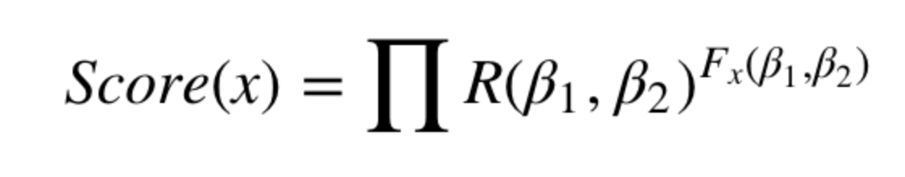
We will create a decryption key, which is a 26 letter string with all alphabets that appear exactly once, then we will map the decryption key into a string of 26 letters in alphabetical order
Decryption key: “ICZNBKXGMPRQTWFDYEOLJVUAHS”
For example, “I” maps to “A”, “C” maps to “B”, “Z” maps to “C”, and so on
To solve this problem, we will be using the monte carlo markov chain
We will be using the scoring function:
R function: record the number of times that specific pair of letter (e.g. “TH”) appears consecutively in the reference text
Fx function: record the number of times that pair appears when the ciphertext is decrypted using the decryption key x
Notes:
More slides, bigger fonts
Talk more about the score function

Slide 6
chooses a random current state (a pair of random letter)
Propose a new state by swapping the two random alphabets in the current state
Use the scoring function to determine whether we should stay in the current state or move to the proposed state
If score of proposed state > score of current state, we move to the proposed state.
Else, we will flip a coin that has a probability of the Score_P/Score_C for the Heads
If the probability is > 1, we accept the case, which means that we move to the proposed state
Score_P = score of proposed state
Score_C = score of current state
Then we will repeat this process all over again starting from step 2

Slide 7
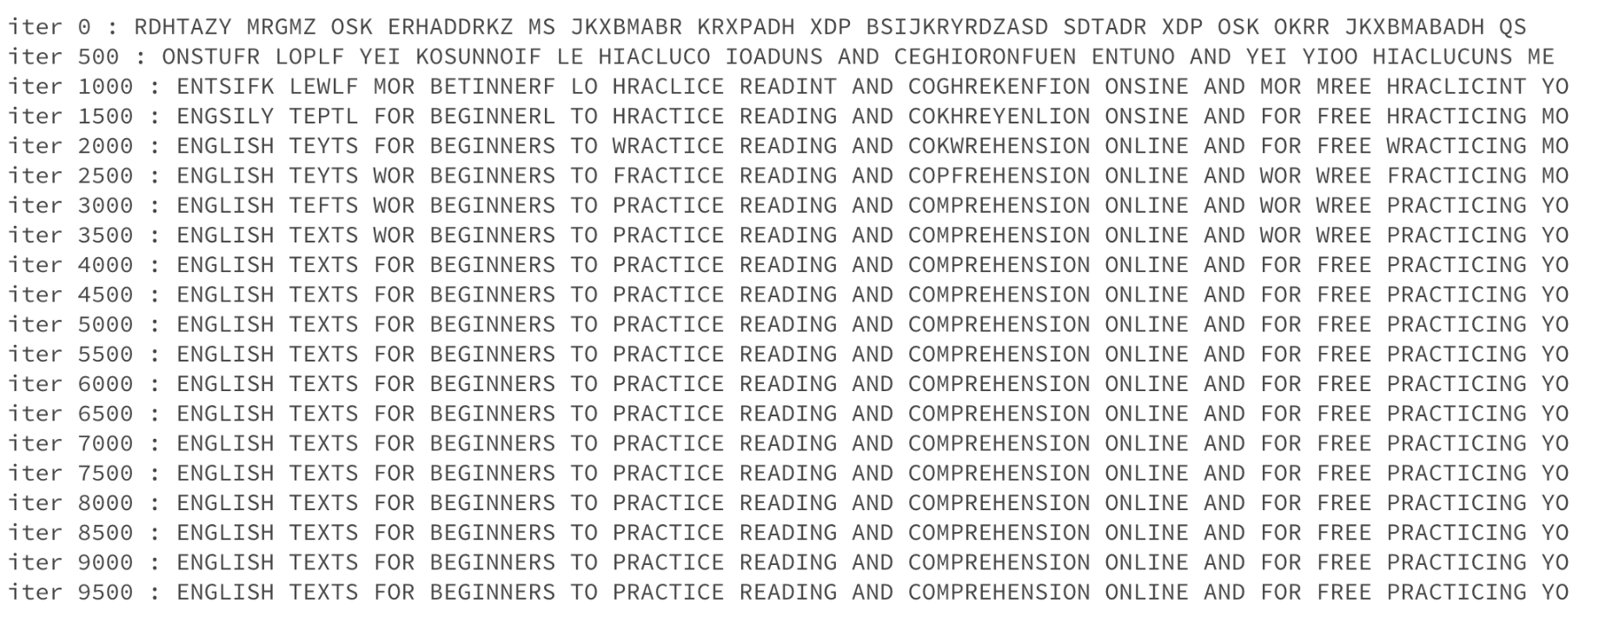
Results
Notes:
Visualization tools: proportion of correctly decrypted alphabets in a graph
Maybe use our own examples/code

Slide 8
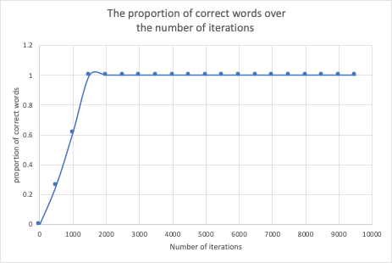

Slide 9
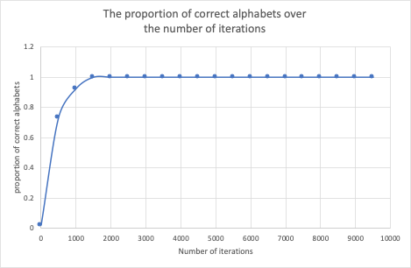

Slide 10
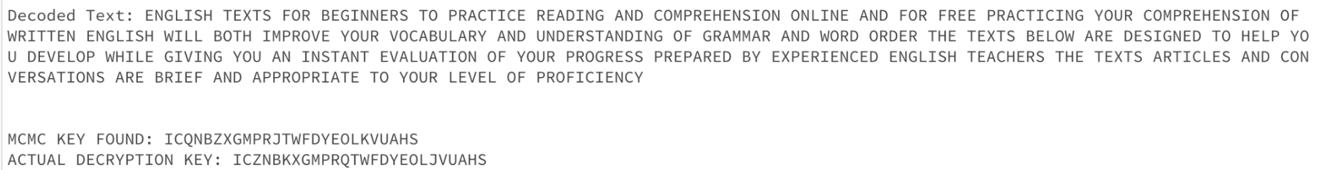
turns it into something that is readable and meaningful

Slide 11
Discussions
This cryptography technique is very important especially for securing information so that no one will be able to access and process the information
Nowadays cryptography is everywhere, for example, we use it to securely send passwords for online purchases.
At first, it was pretty hard for me to understand the concept of cryptography and how MCMC plays a role in it
Notes:
Talk about how you feel?

Slide 12
References
Agarwal, Rahul. “Applications of MCMC for Cryptography and Optimization.” Medium, Towards Data Science, 25 Dec. 2019, towardsdatascience.com/applications-of-mcmc-for-cryptography-and-optimization-1f99222b7132.
Rizzo, Maria L. Statistical Computing with R. CRC Press LLC, 2019.

Slide 13
THANK YOU!

